Slide 1
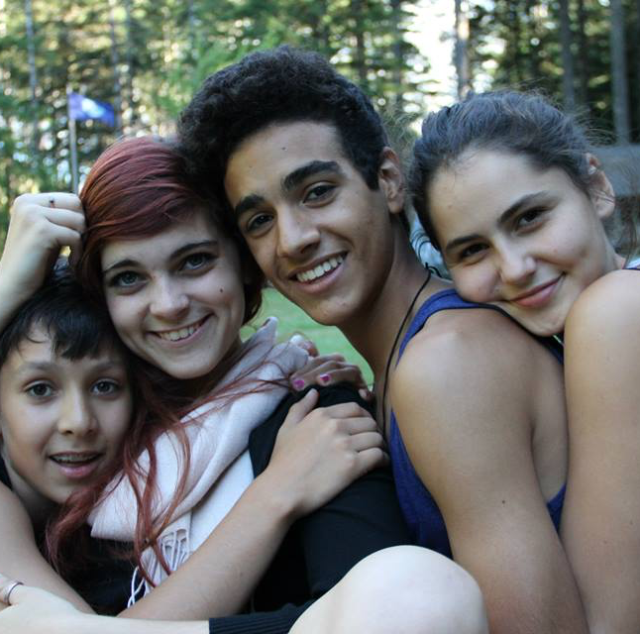
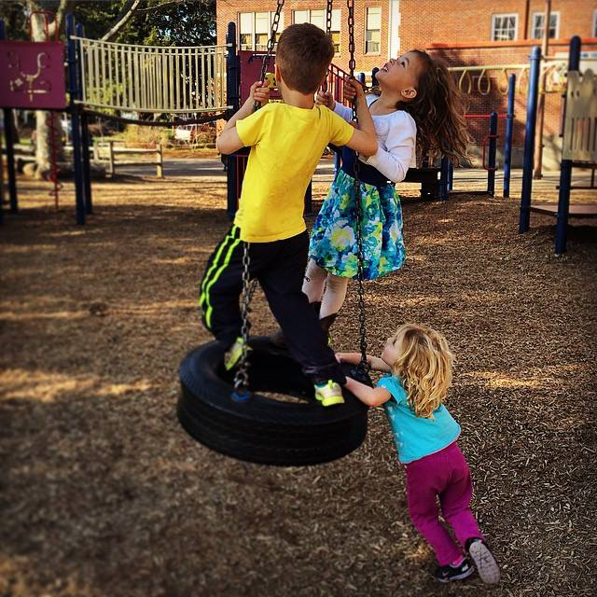
Seeing Students in Context
Social Awareness for Educators
Sophie Biddle

Slide 2
Outline
Introduction
Group Agreements
Define social awareness
Identify ways to grow
Awareness activity
Discussion / debrief
Take home tips
Notes:
So thank you all so much for being here. Today we’re going to spend some time talking about building social awareness as educators, and how that impacts our interactions with students and families. I’ll give a quick intro about myself, we’ll make some group learning agreements, and then we’ll dive into defining what social awareness is. We’ll identify ways we can grow in our own journey of social awareness, and do a related activity. After that we’ll debrief in pairs and as a large group, and talk about how we take this information back to our communities in actionable ways.

Slide 3
About Me
School history: Catholic/private, public school, charter arts, online, free & democratic, unschooling, community college, university.
Kiddo history: youth stage manager, nanny, Village Free School intern, Not Back to School Camp med team
BA in Sociology & Elementary Science Education
Published undergrad research on children’s rights and children’s geographies
Curriculum Specialist at University of Washington College of Education
Creating professional development materials for educators in out-of-school time
Leading Youth Advisory Committee work
Notes:
To set context of who I am and what brings me to this work: My name is Sophie, I currently work as a curriculum specialist at the University of Washington at a research center in the college of education. I create professional development materials for adults working with kids in Expanded Learning Opportunity programs, so any context where adults are working with young people outside of a traditional public school setting. Part of my work also includes leading our Youth Advisory Committee, which I love because bringing young people into research and policy discussions is really where my heart is.
I come to this work with a pretty colorful background. I’ve dabbled in almost every type of school you can think of. I spent most of my elementary school years in a private catholic school, then moved to public school, and burned through a charter arts, online, and a few other models before settling into unschooling in high school. I started community college classes when I was 16, and later transferred to Portland State.
I’ve also been working with kids and teens in some capacity for the last 13 years. I’ve been a youth theater stage manager, nanny, I interned at Village Free School for two school years and also served in a number of roles at Not Back to School camp.
I graduated from PSU with a degree in Sociology and Elementary Science education. During my time at PSU I was fortunate to have the opportunity to publish two pieces of original research, and take my undergraduate thesis overseas to present at an international conference in the U.K.
Could we go around and share our names, pronouns, and maybe where we’re working with young people?

Slide 4
Group Agreements
How do we want to agree to be in this space?
How do we want to feel?
How do we want to be treated?
Notes:
SUPPLIES: Large paper or white board?
One of my number one tips for creating an environment that is safe and allows people to authentically show up is to co-create group agreements. Today we’re all taking on some big work, talking about social awareness. Doing this together means we’re consenting to learn in public, and that requires bravery and vulnerability. So before we move forward, I want to spend about 10 minutes thinking through: How do we want to agree to be in this space? How do we want to feel? How do we want to be treated?

Slide 5
What is Social Awareness?
CASEL Framework:
  Perspective-taking
  Empathy
  Appreciating diversity
  Respect for others
Skills are guideposts
Help us see others and ourselves in context of our world
Notes:
CASEL is an organization that’s been researching social-emotional skills for over 20 years, a lot of schools use their curriculum today. They have a framework of social-emotional skills that highlights 5 core competencies, and social awareness is one of those 5.
CASEL defines social awareness as:
“Ability to take the perspective of and empathize with others, including those from diverse backgrounds and cultures.”
“Understand social and ethical norms of behavior”
“Recognize family, school, and community as sources of [strength] and resources.”
One thing I really like about the CASEL framework is that each core competency has a handful of specific skills to help guide growth. The skills related to building strong social awareness are:
Perspective-taking
Empathy
Appreciating diversity
Respect for others
Social awareness doesn’t mean you’ve perfectly cultivated so much empathy that you let your students set the building on fire or emotionally bankrupt you. It means that as the adult in the room, you are consciously deciding to pause, and think through the person or people you’re talking to or creating space for. You’re thinking to yourself: how could they be feeling? What could their perspective of this situation be? How could that be different than my feelings or perception? The follow up to this is appreciating and respecting that those differences can be a strength and a source of knowledge for you and your learning community. It's totally okay if you don't like or don't agree with those perspectives and feelings. Respect doesn't mean agreement, or being a doormat. It means you are giving genuine regard for what those feelings and perspectives are, and aiming to respond to them out of a compassionate and understanding place.

Slide 6
Why social awareness?
Safety = foundation for learning
Build compassionate and safe learning spaces
Different people have different lived experiences & needs
Your skills enhance the skills of your students
Notes:
Social awareness helps us create safe, compassionate classrooms that allow all students and prospective students learn better and feel safe at school.
Safety is the foundation for learning. You can learn new skills if you’re constantly stressed out or hyper aware of either hiding parts of yourself or bracing for ignorant remarks that make you feel bad.
Ultimately - we aren’t a homogenous society with a singular true experience. Social awareness allows us to build learning spaces that honor and uphold the multiple truths and ways of knowing our students bring. Social awareness as an educator is critical. It allows us to authentically hold space for holistic development, promotes empathy and compassion between young people and adults, and creates a space where all students can comfortably voice their interests and strengths.

Slide 7
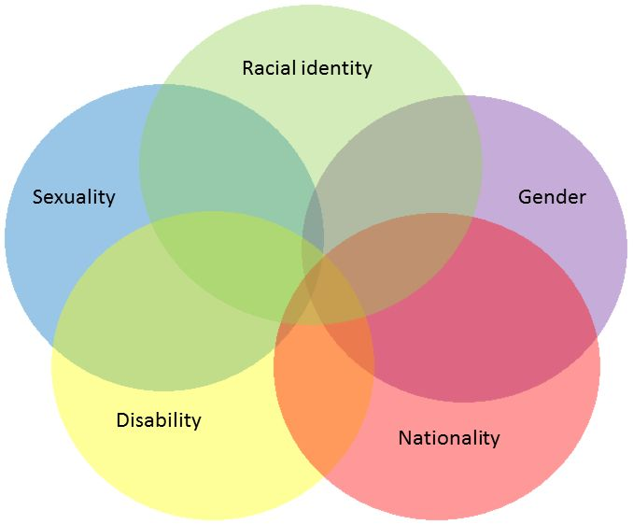
Intersectionality
The overlap of different social categories that create unique privileges or barriers
Plus:
Native language
Family income
Home culture
Where you live
Body size
Age
Education
Notes:
Another theoretical framework that I find useful when thinking about social awareness is Dr. Crenshaw’s theory of intersectionality.
Intersectionality is a theory that Dr. Kimberle Crenshaw created to explain how different identities or social categories: like race and gender intersect to create a particular form of discrimination. One example Dr. Crenshaw pulls from is a court case where a black woman sued a car dealership for hiring discrimination – saying she didn’t get the job because the employer was biased. The judge threw out the lawsuit because the car dealership did hire black people, and it did hire women. However! All the black people were men who worked as mechanics away from the public, and all the women were white women who worked as secretaries. The combination of being black AND a woman did result in discrimination, if she had been a white woman or a black man, she would’ve likely been employed by the car dealership.
We all have different social categories or identities that overlap and give us disadvantages or advantages depending on the context. This graphic here covers some of the possible social identities we can have, but not all of them. For example native language, family income, home culture, where you live, body size, age, education, and more all contribute to making up how we are perceived by others, what is considered “acceptable” for us to do, and what opportunities are more or less accessible to us.

Slide 8
How to grow social awareness?
We’re all on a journey… ☺
Self awareness informs social awareness
Understand how our own identities overlap
See and respect others’ unique social positions
Notes:
We’re all on a journey… we’re never complete or done learning – and I hope this is an exciting thing. I know we all encourage the kids we work with to keep learning, keep growing, and I want to encourage you to continue learning and growing in social awareness, too. I’m always learning, making mistakes, and trying to grow too.
Interestingly, self awareness informs social awareness. CASEL curriculum actually has teachers start teaching all social-emotional skills with lessons on self awareness.
So We can start with enhancing our social awareness by understanding our own many identities, how those are seen and unseen by others, and how the overlap/ simultaneous existence of those identities makes up who we are and how we move through the world
In other words, understand the theory of intersectionality in terms of how it impacts us, and we can then extend that understanding towards others, especially the young people we work with.

Slide 9
Activity: Map Your Identities
One side to be your externally visible self / identities / labels
Pick one side of the paper to be your private hidden/ not visible self
Use post-it notes to create individual identities and labels for yourself. One per note.
Think about:
  What makes up an identity? Is it about how you see yourself, how others see you? A combination?
  What experiences form our identities?
  What relationships form our identities?
Notes:
We’re going to practice understanding our many identities. In this activity we’re going to have a lot of time to share and discuss with people next to us and as a large group. I want to be very clear that all sharing is optional. This work can sometimes be surprising and vulnerable, and it’s okay to keep as much or as little of your work private as you’d like. Let’s also remember our group agreements for learning together [riff on whatever the agreements are].
So, some identities are visible to others and some aren’t. For example, you can look at me and see some of my identities: I’m white, I’m a cis-gender woman. Other things you can’t see, for example you don’t see my Catholic upbringing, or know if I graduated college or not. I want to invite you to think about what these external identities: like race and gender presentation are perhaps similar to or different from your internal identities: like your religion, sexual orientation, or job –or even whether or not you’re a parent, that can be a big one that is sometimes externally visible and other times not.
I’m going to pass out these papers, and go ahead and pick one side to be your external, or outward facing, side and one side that will be your internal, or sometimes invisible to the public side.
Then you can use these post-it notes and markers to put your identities, labels, and social categories. Go ahead and stick them to each other, on the paper, however it makes the most sense to you to map your identities. I’d encourage you to put on identity per note.
For example, [model – take 1 paper and 3 notes: woman, native English speaker, hiker because I love hiking and spend a lot of my time outside. Being a hiker is related to my body’s abilities, so I might go on to make a post it note about that and stick them together. But maybe not.
Does that all make sense? Any questions so far?
Okay, go ahead and spend about 15 minutes on your own work, and then we’ll take some time to share.

Slide 10
Discussion: Small groups
Pick 1 – 2 prompts that interest you:
What did you notice when you did this activity?
Do any identities feel empowering?
Did any of your identities conflict with each other?
Did any identities feel imposed? Invisible?
How did it feel in your body to share any of this activity with others?

Slide 11
Discussion: All Together
How do these individual post-it notes make up who we are?
How does our position at the intersection of all these identities shape the way we move through the world?
How does this activity and thinking about identities extend to the young people and families we work with?

Slide 12
Let’s take a break
Come back in 5 minutes!

Slide 13
Back to Theory
Goal: Student agency, autonomy, self-actualization
Educator social awareness = safe, welcoming learning environment
Responsive support for current students and families
Responsive messaging to prospective students
Amplifying and actively partnering w/ people historically left out of alternative education spaces
Empathic and empowered children
Notes:
The goal of learning spaces, especially self-directed ones, is to reach this idea of agency, autonomy, and self-actualization through empowering and responsive learning environments.
Without educators’ social awareness - an awareness, understanding, and appreciation of how your students move through the world and how those experiences might be similar or different from yours - this goal can’t be reached. Creating spaces that are safe, where young people can share about themselves and their diversity be seen as a true strength, leads to the outcome we want. Social awareness as an educator is the foundation for creating that kind of space.
The way we communicate with families about the value of self-directed education spaces can also be informed by social awareness. It’s natural and easy to think that all people move through the world, know the world, and are experienced by the world the same way we are. However, this isn’t true. We can see this all the time in present-day issues of police violence, the Me Too movement, and the climate strikes all show that our social position and the intersection of all our identities deeply impacts our lived experiences. Our identities and lived experiences also impact our values and what motivates us. We’re not all motivated by competition, or by a sense of individualism. Social awareness can help us target support and better tailor messaging and explanations of alternative education movements to communities that are historically left out of these discussions. It can also help us better facilitate discussions and establish what type of support different individuals and families need once they’re part of our schools, learning centers, or summer camps. This is particularly true for immigrant, refugee, POC, and poor communities which often lack a space at the table in these largely middle to owning class, white, highly credentialed spaces.
Ultimately: establishing and building your social awareness as an educator helps you create strong empathy and social skills for your students, and empower them to create a more just and equitable world, which we so sorely need. And this work is your work. You are helping change the world by modeling the skills of social awareness to your students: showing them perspective-taking, empathy, respect, and appreciation for everyone in your classroom and beyond.

Slide 14
How do we apply this?
Continuously hold:
  Think about the young people you work with, what would their identities be?
  How are you making space for them to share these identities with you?
Keep learning!
  Read newspaper articles, social media accounts, books, and listen to podcasts written by people who have a different social position from you
Talk to your students. Listen without an agenda.
Notes:
Okay, great, hopefully we’re bought in on the importance of social awareness. How do we bring this home?
Continuously hold:
Think about the young people you work with, what would their identities be?
How are you making space for them to share these identities with you?
Keep learning!
Read newspaper articles, social media accounts, books, and listen to podcasts written by people who have a different social position from you
Talk to your students. Listen to their lives, experiences, and perspectives without an agenda other than listening.

Slide 15
Socially Aware Spaces
Who is represented in your space?
What stories are told in images, books, movies, poems? Who’s stories aren’t told?
How do you communicate complex stories, rather than glossed over, simple stories that tokenize or simply “check off” the diversity box?
Notes:
Space: Who is represented in your space? What stories are told in images, books, movies, poems? Who’s stories aren’t told? How do you communicate complex stories, rather than glossed over, simple stories that tokenize or simply “check off” the diversity box?

Slide 16
Social Awareness in Teaching
Facilitation strategies:
  Write and regularly revisit agreements with students
  Activities centered on learning more about their own communities, cultures, and histories
  Let people share or not share in all settings
  Model vulnerability
  Provide opportunities to engage in structured get-to-know you time throughout the whole year.
Notes:
Facilitation:
Write and regularly revisit agreements with students – congrats y’all have been practicing social awareness this whole time!
Invite young people to participate in activities centered on learning more about their own communities, cultures, and histories
Let people share or not share in all settings
Model vulnerability: take part in activities, sit with them at lunch, and share appropriate and authentic things about yourself
Provide opportunities to engage in structured get-to-know you time throughout the whole year. Make these times flexible / use many ways of engaging with others: art, writing, small and large group discussion.

Slide 17
Wrapping Up
What strategies do you already use that support spaces of safety, belonging, and social awareness?
What’s one thing you’re excited to bring back to the spaces where you work with young people?
Notes:
Large group, popcorn-style. Does anyone want to share:

Slide 18
Thank you
Sophie Biddle
skbiddle@gmail.com

