Slide 1
Billy Gryphen’s House and Other Important Places: The Children’s Geography of the Arcadia Neighborhood
Sophie Biddle
Portland State University (USA)
Notes:
Hi everybody. My name is Sophie Biddle. My advisor is Amy Coplen, and my thesis is titled Billy Gryphen’s House and Other Important Places: The Children’s Geography of the Arcadia Neighborhood.
I investigated how kids ages 5 – 12 years old use, see, and value public spaces in an urban neighborhood in Portland, Oregon. The neighborhood, along with all the participants, has a pseudonym to protect the kids’ identities and privacy.
Portland is trying to address children’s rights in light of the United States failure to ratify the UN Convention on the Rights of the Child. In 2006 Portland became the first U.S. city to pass legislation granting children basic human rights. The Bill of Rights for the Children and Youth of the City of Portland and Multnomah County states that children have the right to voice their opinions on community matters. The passage of that legislation is an important step in creating communities that acknowledge the rights of all residents. However, to the best of my knowledge there is no data on how children ages 5 – 12 years old interact with the built environment in Portland. We say that children have the right to voice their opinion on community matters, but we’ve so far done nothing to actually listen to what children have to say. My research aimed to amplify children’s voices about how they relate to and use public space in their Portland neighborhood. Which brings me to my research design

Slide 2
Research Design: The Mosaic Approach
Mapmaking & Focus Group Interviews
Photojournalism & Walk-Around Interviews
Participant Observation
Notes:
For this project I built upon Alison Clark’s “Mosaic Approach” which is a form of participatory action research tailored toward children. For my research data came from three sources: a mapmaking activity at the local library, which also served as a focus-group interview setting. A photojournalism project coupled with “walk-around” interviews, where kids lead me on a walk through their neighborhood, and participant observation.
Participants were self-selected members of the local community. In all, 21 kids chose to participate. The majority of participants were girls. The age distribution was surprisingly even.
This research methodology provided really interesting results. By collecting their stories, drawings, and photos I found myself immersed in these kids’ world.

Slide 3
Key Finding #1:
Defining the Neighborhood
Age: younger kids typically depict smaller geographic ranges than older kids
Personality: more outgoing kids discuss larger neighborhood ranges
Sense of autonomy: Neighborhood boundaries are based on areas of independence
Notes:
I identified three key themes in my data. The first is how kids define the neighborhood. Children’s definition of the neighborhood is flexible and evolving. An individual child’s age, personality, and personal sense of autonomy are layers that help to create the ethos of “the neighborhood.”
Younger kids ages 5 -7 years old, generally depict their neighborhood as their family’s house. Younger children’s maps will often include part of a yard, a special tree, the weather, sometimes part of a driveway. Older kids maps typically included labeled streets, their house in relation to friends’ houses, the local library, and sometimes the public elementary school.
A child’s personality, specifically how introverted or extroverted a particular child is, ties to the scale of the neighborhood. Kids who demonstrated more dominant personalities and expressed interest in large group activities discussed large neighborhood ranges. In contrast, their peers who demonstrated quieter personalities and expressed interest in small group or individual activities had smaller than average neighborhood ranges, despite having similar parent sanctioned boundaries for roaming the neighborhood.
A child’s personal sense of autonomy is the third factor that impacts the scale and definition of the neighborhood. Children value spaces where they feel they can be self-directed and are either totally unsupervised, or at least indirectly supervised, by adults. For younger children, ages 5 – 7 years old, avoiding adult supervision is almost impossible outside of the home. This helps explain why young children will draw their family homes with great detail while placing little significance on any other part of their neighborhood.

Slide 4
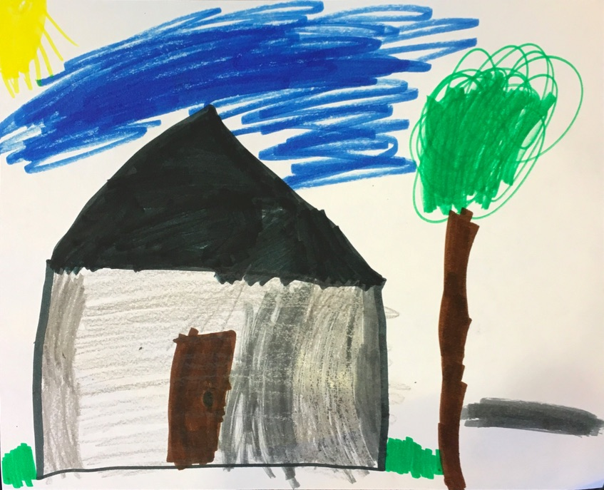
Notes:
This map is a typical map for kids ages 5 – 7 years old. This one was drawn by Liam, who was 5 years old. Here you can see his family’s driveway, the weather, and a special tree. As you can see his home takes up the majority of the space on this map.

Slide 5
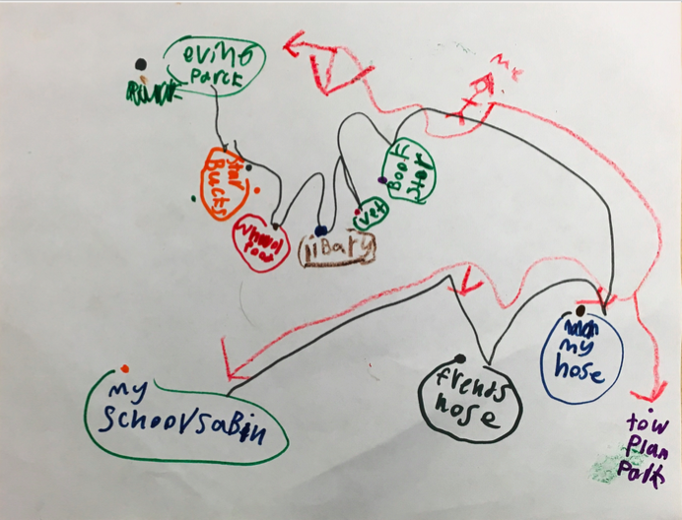
Notes:
This map was drawn by 10-year-old Hailey. You can see how this depiction of the neighborhood is really different from Liam’s. Hailey has her friend’s house near her house, and also drew the library, her favorite parks, and her school. She’s started to indicate a walk-able path as part of her neighborhood too.

Slide 6
Key Finding #2: Community
Kids both participate in and help to create a sense of community
Knowing other kids and adults is indicator of neighborhood feeling “good” or “safe”
Kids strive for socially equitable communities
Notes:
My second key finding is that kids both participate in and help to create community. In these discussions with kids about how they define their neighborhood it became really clear to me that children place a lot of value on participating in and creating community in their neighborhood. I observed that when the kids feel that there are spaces in the community for them, they value the neighborhood as a whole and try to give back to the community at large through active social participation. This giving back manifests as children carefully reading lost animal signs and looking for the lost pets, taking care of and valuing community gardens, doing what they call “random acts of kindness.” Kids also verbally praise what they see as adults’ attempts at creating “cool” and “pretty” playgrounds, sitting spaces, and pieces of public art.
Kids create community with their peers through passing along stories of child-lore. Kids place a lot of value on this sense of community. Knowing other people was the strongest indicator of a child feeling like the neighborhood is a good or safe place to live.
I also learned that kids really want their community to be socially equitable. Kids of all ages were quick to give me a laundry list of recommendations on how to improve the neighborhood and at the top of their lists would be additions that addressed social inequality. Adding a homeless shelter was a common idea, and a few kids also pointed out that the community gardens are closer to the higher income sections of this neighborhood rather than near the low-income housing developments. One 10-year-old emphatically recommended more accessible sidewalk design. After being on crutches for a month prior to this study this kid noticed that most of the curbs don’t have ramps and that ramps can, in her words, “help all kinds of people like people in wheelchairs, people with bikes, or with strollers.”

Slide 7
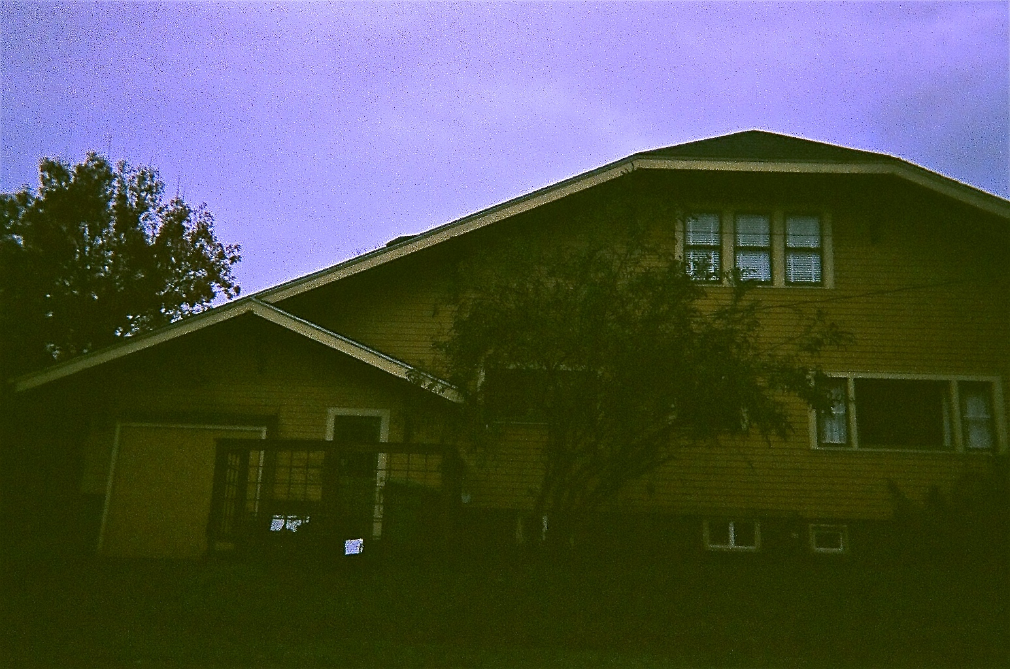
Notes:
This is a photo of Billy Gryphen’s house taken by 9-year-old Silvie. Billy Gryphen’s house is a mysterious site of child-lore. The notoriety of the house seems disconnected from any adult-oriented rationale, and even the kids were unable to explain what specifically made Billy Gryphen’s house important. I also spent close to two years in the neighborhood working on this project and never once saw anyone at this house. Nonetheless, it occupied a larger than life role in the children’s geographies of the Arcadia neighborhood.

Slide 8
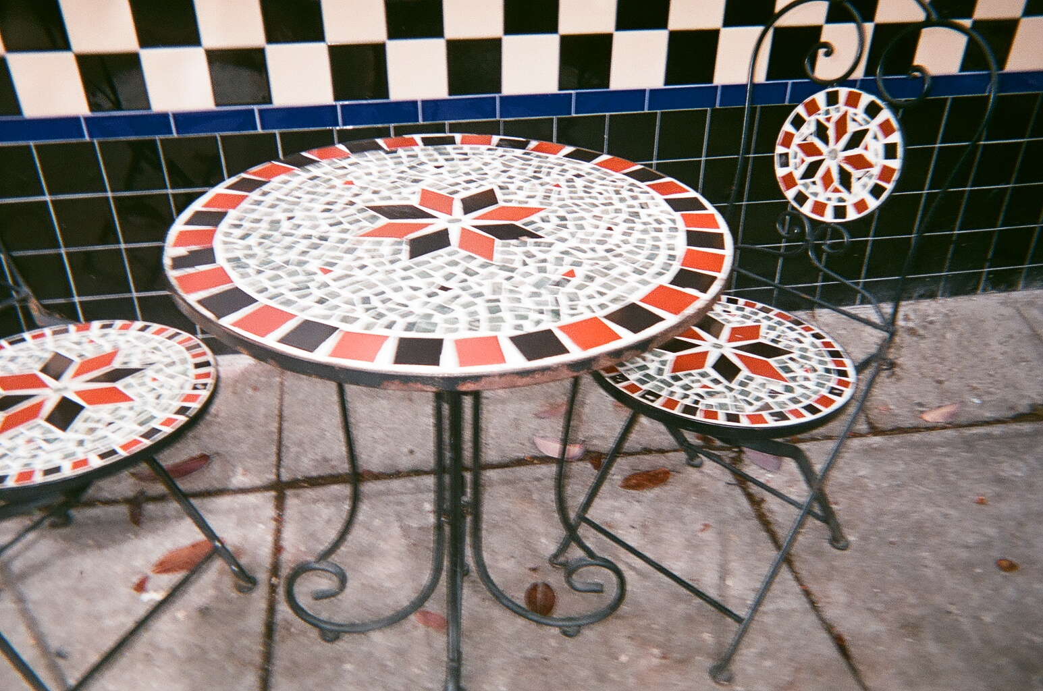
Notes:
These table and chairs are outside a coffee shop. They appeared in a number of kid’s photographs because the kids admire the tile work, they think it’s really pretty. This example of kids praising adult’s contributions to the neighborhood was taken by 9-year-old Ella.

Slide 9
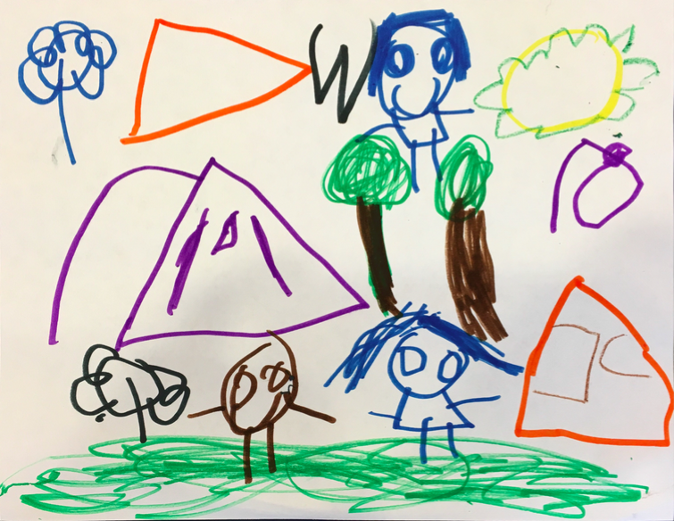
Notes:
This map is by 5-year-old Tiana. Tiana lives on the edge of this neighborhood in an affordable housing complex. She told me she was drawing her community, and that she was adding flowers to show that she needed more gardens by her house.

Slide 10
Key Finding #3:
Socio-Spatial Geographies
Kids’ geographies are socio-spatial. Places have meaning based on social significance.
Kids value places of emotional and physical sustenance: play areas, gardens, etc.
Valuing space based on social significance shows complex understanding of place & community
Notes:
My third key finding is that kid’s geographies are socio-spatial. Places have meaning based on their social significance, and vice versa. Children value public space in the Arcadia neighborhood based on how that place sustains them physically, emotionally, and socially. Places that foster physical and emotional wellness are valued within children’s social worlds. Public spaces that allow for autonomous free play, caregiver and child bonding time, or acknowledges children’s roles in the community are particularly important spaces to children in Arcadia. Children actively seek out and request places that improve their quality of life, such as community gardens and safe play areas. I argue that kids demonstrate a socio-spatial understanding of public space because of how they construct value for their built environment. This shows a complex understanding of place and community.

Slide 11
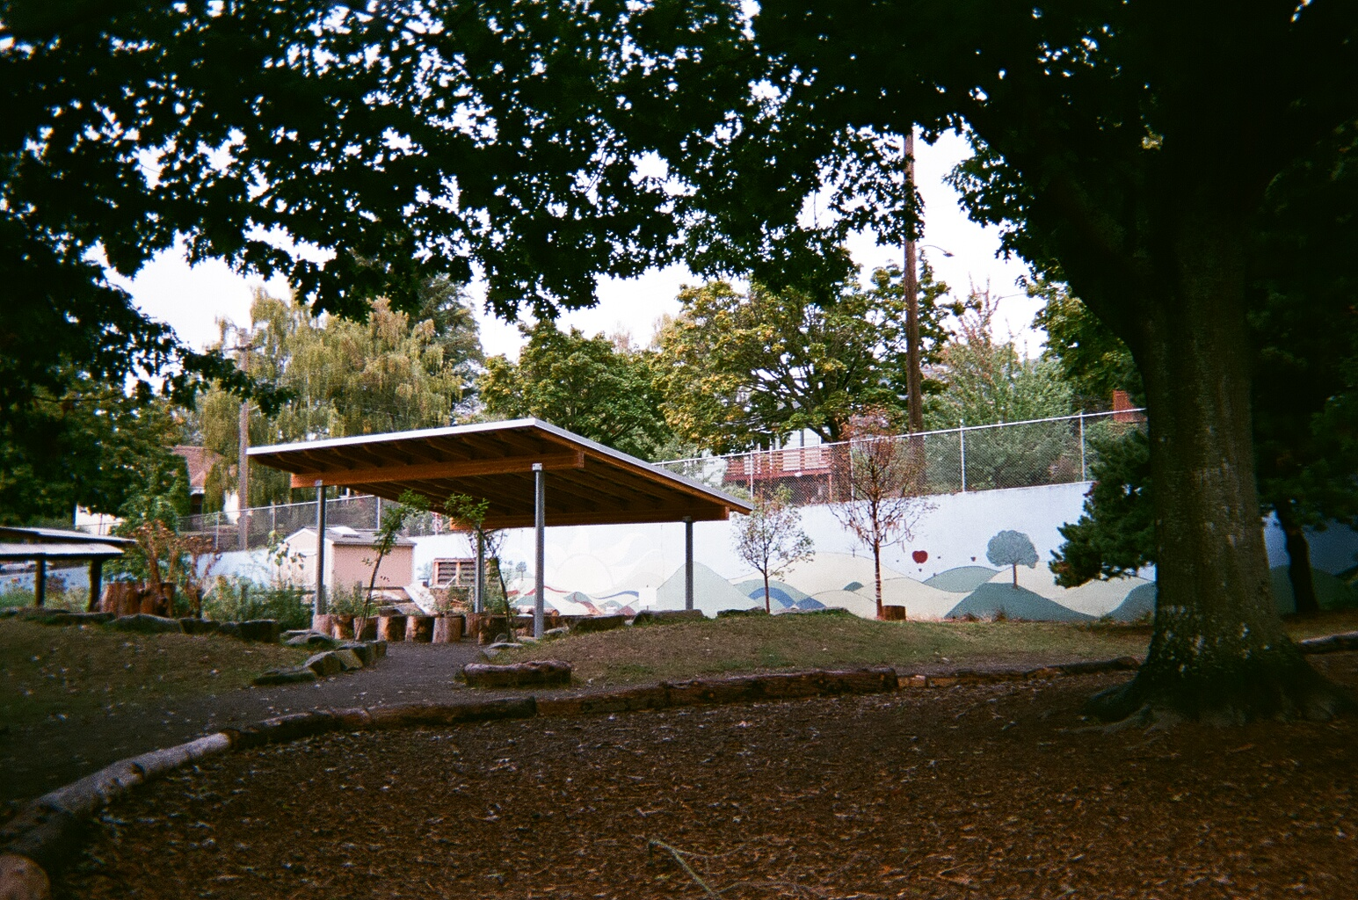
Notes:
This photo is by 12-year-old Rose. A group of older girls took me to this tree back here. It’s called the wishing tree. One of their classmates died and this is his memorial tree. The strips of fabric have wishes that the kids wrote on them. This tree appears often in kids’ photos of important places.

Slide 12
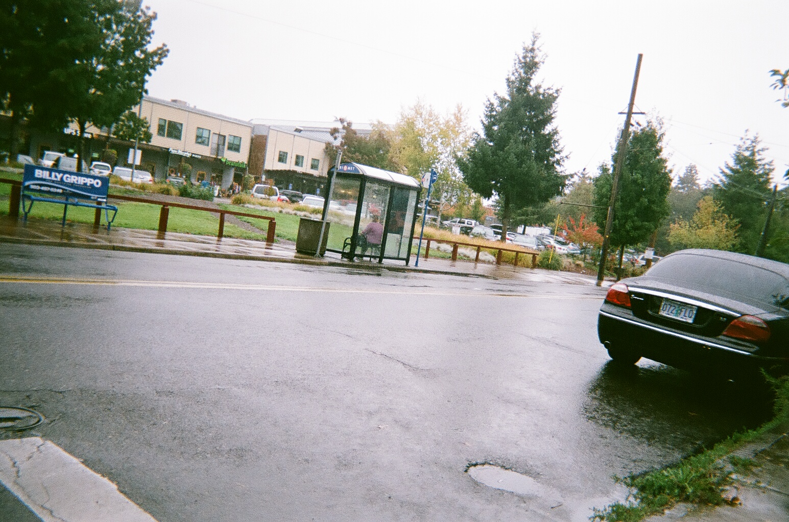
Notes:
I also included this photo of a bus stop and business center by 7-year-old Reese. Across socioeconomic boundaries, riding the bus with parents was a highly valued activity for the participants in this study. This business center also holds the library, which the kids in this study place a lot of value on.

Slide 13
What’s Next
Take kids seriously.
Create child-friendly participation models for civic participation, research practices
Uphold CRC principles
  Portland: “Our Bill of Rights: Children & Youth”
Notes:
So, what’s next?
First, I argue that we need to take kids seriously. The children in this study demonstrated a complex understanding of community, public space, and the neighborhood. Children take pride in their roles as co-creators of public space in their neighborhoods and desire to be seen as competent, valuable members of their community.
Children in Arcadia feel largely ignored by the adult community when it comes to listening to children’s voices on decisions that affect them. The Neighborhood Association could rectify this by better enabling youth participation. This could look like holding community meetings at accessible times, such as weekend afternoons, and also setting aside time during the meeting for youth to bring specific requests or issues to the attention of the community. These changes would help the neighborhood conduct itself in accordance with The Bill of Rights for the Children and Youth of the City of Portland and Multnomah County. On an international level, researchers must uphold the principles of the UNCRC by embracing respectful research practices that treat children as competent, aware human beings.
I argue that it’s time to acknowledge children’s inherent personhood. By incorporating children’s thoughtful, insightful, and sincere concerns in our neighborhood design and planning process, we create communities where equal value is placed on all members’ experiences of shared spaces.
Thank you.

